Slide 1
Angular Web Security
Securing Angular Apps
Lecture 1
By James(Jin) Wang
07/2020

Slide 2
Outline
Securing Angular Apps with OpenID connect and OAuth2
The Redux Pattern
NgRx case study

Slide 3
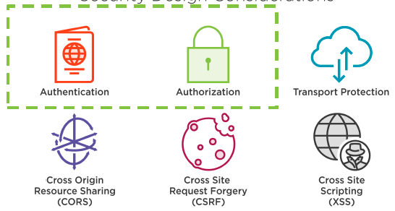
Securing Angular Apps
  Security Design Considerations

Slide 4
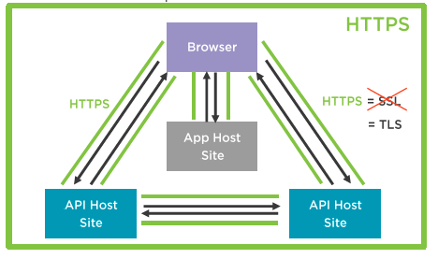
Securing Angular Apps
  Transport Protection

Slide 5
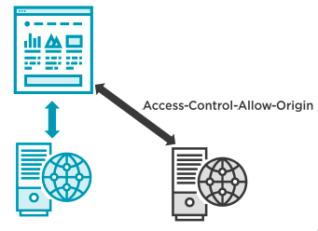
Securing Angular Apps
  Cross Origin Resource Sharing (CORS)

Slide 6
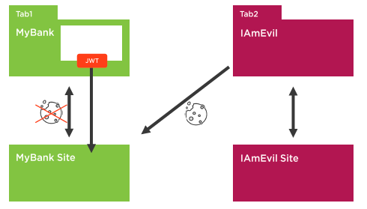
Securing Angular Apps
  Cross Site Request Forgery (CSRF)

Slide 7
Securing Angular Apps
  Cross Site Request Forgery (CSRF)

Slide 8
Summary

